Slide 1
COMP 3500 Introduction to Operating Systems OS Overview (cont.)
Dr. Xiao Qin
Auburn University http://www.eng.auburn.edu/~xqin
xqin@auburn.edu
Slides adopted from Drs. Abraham Silberschatz, Peter B. Galvin, and Greg Gagne
Notes:
5 minutes show Canvas discussion. Use Canvas to post questions.
?? min Ex 4 and 5 will be covered on Lec01c-OS Overview cont
?? min Lec01c-Project 2 Overview

Slide 2
The Latest CSSE Exit Survey
Like large programming projects.
Some lectures were taught by graduate teaching assistant.
Prefer being taught by faculty members of CSSE

Slide 3
About Dr. Qin
Undergraduate Student at Huazhong University of Science and Technology (HUST), China (1992-1996)
Senior Design Project: Real-Time Disk Scheduling in Unix
M.S. Student at HUST, (1996-1999)
Scheduling in Real-Time and Fault-Tolerant Operating Systems
Doctoral student at the University of Nebraska-Lincoln (01-04)
I/O-Aware Load Balancing
Assistant Professor at New Mexico Tech (2004-2007)
Security-Aware Scheduling
Assistant Professor at Auburn University (2007-2010)
Energy-Efficient Storage Systems
Associate Professor at Auburn University (2010-2015)
Active Storage Systems, Prefetching for Multi-level Storage Systems
Professor at Auburn University (2015)
Thermal-Efficient Data Centers

Slide 4
About Me: What are operating system goals?
A program that acts as an intermediary between a user of a computer and the computer hardware
Operating system goals:
Execute user programs and make solving user problems easier
Make the computer system convenient to use
Use the computer hardware in an efficient manner
Notes:
Goals:
Run program
Users: easy use computer systems
Applications: hardware efficiency

Slide 5
Recap: What are operating system goals?
A program that acts as an intermediary between a user of a computer and the computer hardware
Operating system goals:
Execute user programs and make solving user problems easier
Make the computer system convenient to use
Use the computer hardware in an efficient manner
Notes:
Goals:
Run program
Users: easy use computer systems
Applications: hardware efficiency

Slide 6
Recap: What do users and mainframes want from operating systems, respectively?
Convenience
Resource utilization
Ease of use
Fast throughput
Short response time
Low cooling cost
Long battery life
Notes:
User vs. System views
Users want convenience, ease of use and good performance
Don’t care about resource utilization
But shared computer such as mainframe or minicomputer must keep all users happy
Users of dedicate systems such as workstations have dedicated resources but frequently use shared resources from servers
Handheld computers are resource poor, optimized for usability and battery life
Some computers have little or no user interface, such as embedded computers in devices and automobiles
Users:
Convenience
Ease of use
Short response time
Long battery life
Mainframes:
Resource utilization
Fast throughput
Cooling cost

Slide 7
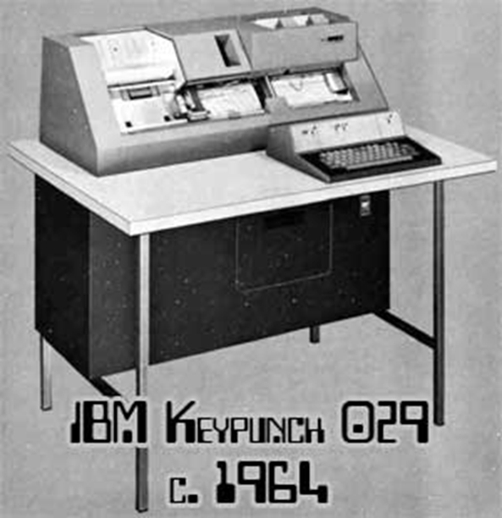
Recap: How to reduce the long system setup time of a serial processing system?
Notes:
Story: Wang PC 1968
ItemUnit CostCPU + 4KB RAM$4,950
4KB RAM expansion$2,500
Selectric terminal$4,200
Terminal control unit$500
Cassette storage$1,400
BASIC software and system setup$1,500
Just as multiprogramming allows the processor to handle multiple batch jobs
at a time, multiprogramming can also be used to handle multiple interactive jobs. In
this latter case, the technique is referred to as time sharing , because processor time is
shared among multiple users. In a time-sharing system, multiple users simultaneously
access the system through terminals, with the OS interleaving the execution of each
user program in a short burst or quantum of computation. Thus, if there are n users
actively requesting service at one time, each user will only see on the average 1/ n
of the effective computer capacity, not counting OS overhead. However, given the
relatively slow human reaction time, the response time on a properly designed system
should be similar to that on a dedicated computer.
Timesharing (multitasking) is logical extension in which CPU switches jobs so frequently that users can interact with each job while it is running, creating interactive computing
Response time should be < 1 second
Each user has at least one program executing in memory process
If several jobs ready to run at the same time  CPU scheduling
If processes don’t fit in memory, swapping moves them in and out to run
Virtual memory allows execution of processes not completely in memory

Slide 8
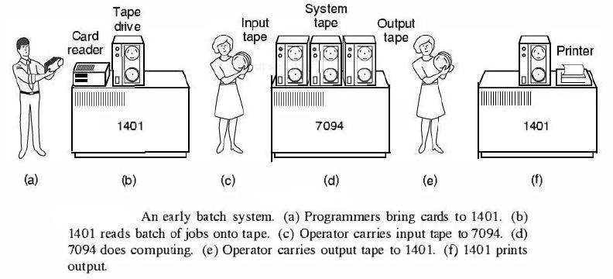
Simple Batch Systems
Early computers were very expensive
important to maximize processor utilization
Monitor
user no longer has direct access to processor
job is submitted to computer operator who batches them together and places them on an input device
program branches back to the monitor when finished
Notes:
Early computers were very expensive, and therefore it was important to maximize
processor utilization. The wasted time due to scheduling and setup time was
unacceptable.
To improve utilization, the concept of a batch OS was developed. It appears
that the first batch OS (and the first OS of any kind) was developed in the mid-1950s
by General Motors for use on an IBM 701 [WEIZ81]. The concept was subsequently
refined and implemented on the IBM 704 by a number of IBM customers. By the
early 1960s, a number of vendors had developed batch operating systems for their
computer systems. IBSYS, the IBM OS for the 7090/7094 computers, is particularly
notable because of its widespread influence on other systems.
The central idea behind the simple batch-processing scheme is the use of a
piece of software known as the monitor . With this type of OS, the user no longer has
direct access to the processor. Instead, the user submits the job on cards or tape to a
computer operator, who batches the jobs together sequentially and places the entire
batch on an input device, for use by the monitor. Each program is constructed to
branch back to the monitor when it completes processing, at which point the monitor
automatically begins loading the next program.

Slide 9
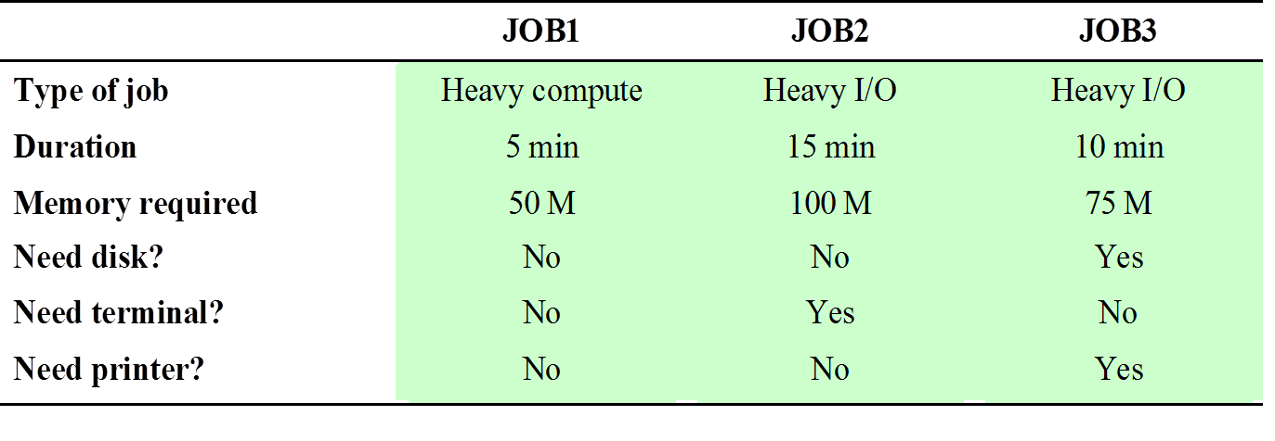
Job Control Language (JCL)
Special type of programming language used to provide instructions to the monitor
what compiler to use
what data to use
Notes:
The monitor performs a scheduling function: A batch of jobs is queued up,
and jobs are executed as rapidly as possible, with no intervening idle time. The monitor
improves job setup time as well. With each job, instructions are included in a
primitive form of job control language (JCL) . This is a special type of programming
language used to provide instructions to the monitor. A simple example is that of a
user submitting a program written in the programming language FORTRAN plus
some data to be used by the program. All FORTRAN instructions and data are on a
separate punched card or a separate record on tape. In addition to FORTRAN and
data lines, the job includes job control instructions, which are denoted by the beginning
$.

Slide 10

Exercise 4: What are problems with simple batch systems?
Under utilized CPU time
Non-interactivity of users with running jobs

Slide 11

Multiprogramming
There must be enough memory to hold the OS (resident monitor) and one user program
When one job needs to wait for I/O, the processor can switch to the other job, which is likely not waiting for I/O
Notes:
This inefficiency is not necessary. We know that there must be enough
memory to hold the OS (resident monitor) and one user program. Suppose that
there is room for the OS and two user programs. When one job needs to wait for
I/O, the processor can switch to the other job, which is likely not waiting for I/O.
Multiprogramming (Batch system) needed for efficiency
Single user cannot keep CPU and I/O devices busy at all times
Multiprogramming organizes jobs (code and data) so CPU always has one to execute
A subset of total jobs in system is kept in memory
One job selected and run via job scheduling
When it has to wait (for I/O for example), OS switches to another job

Slide 12
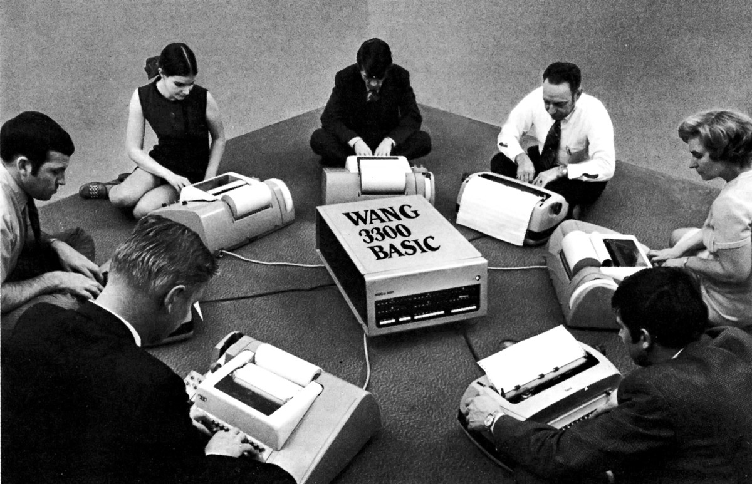
Time-Sharing Systems
To handle multiple interactive jobs
Processor time is shared among multiple users
Multiple users simultaneously access the system through terminals, with the OS interleaving the execution of each user program in a short burst or quantum of computation
Notes:
Wang PC 1968
ItemUnit CostCPU + 4KB RAM$4,950
4KB RAM expansion$2,500
Selectric terminal$4,200
Terminal control unit$500
Cassette storage$1,400
BASIC software and system setup$1,500
Just as multiprogramming allows the processor to handle multiple batch jobs
at a time, multiprogramming can also be used to handle multiple interactive jobs. In
this latter case, the technique is referred to as time sharing , because processor time is
shared among multiple users. In a time-sharing system, multiple users simultaneously
access the system through terminals, with the OS interleaving the execution of each
user program in a short burst or quantum of computation. Thus, if there are n users
actively requesting service at one time, each user will only see on the average 1/ n
of the effective computer capacity, not counting OS overhead. However, given the
relatively slow human reaction time, the response time on a properly designed system
should be similar to that on a dedicated computer.
Timesharing (multitasking) is logical extension in which CPU switches jobs so frequently that users can interact with each job while it is running, creating interactive computing
Response time should be < 1 second
Each user has at least one program executing in memory process
If several jobs ready to run at the same time  CPU scheduling
If processes don’t fit in memory, swapping moves them in and out to run
Virtual memory allows execution of processes not completely in memory

Slide 13
Exercise 5: If there are n users actively requesting service at one time, each user will only see on the average 1/ n of the effective computer capacity, not counting OS overhead. Why the response time on a time-sharing system can be similar to that on a dedicated computer?
Relatively slow human reaction time
Notes:
Story: Wang PC 1968
ItemUnit CostCPU + 4KB RAM$4,950
4KB RAM expansion$2,500
Selectric terminal$4,200
Terminal control unit$500
Cassette storage$1,400
BASIC software and system setup$1,500 Total: 12050
Just as multiprogramming allows the processor to handle multiple batch jobs
at a time, multiprogramming can also be used to handle multiple interactive jobs. In
this latter case, the technique is referred to as time sharing , because processor time is
shared among multiple users. In a time-sharing system, multiple users simultaneously
access the system through terminals, with the OS interleaving the execution of each
user program in a short burst or quantum of computation. Thus, if there are n users
actively requesting service at one time, each user will only see on the average 1/ n
of the effective computer capacity, not counting OS overhead. However, given the
relatively slow human reaction time, the response time on a properly designed system
should be similar to that on a dedicated computer.
Timesharing (multitasking) is logical extension in which CPU switches jobs so frequently that users can interact with each job while it is running, creating interactive computing
Response time should be < 1 second
Each user has at least one program executing in memory process
If several jobs ready to run at the same time  CPU scheduling
If processes don’t fit in memory, swapping moves them in and out to run
Virtual memory allows execution of processes not completely in memory

Slide 14
Summary
Evolution of Operating Systems
Batching
Multiprogramming
Timesharing

